Slide 1
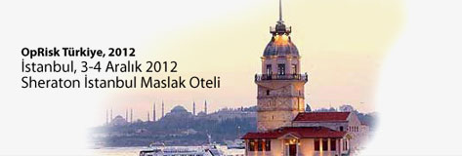
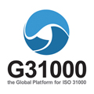
ISO 31000, a risk management standard for decision-makers
Alex Dali, MBA, ARM
President at G31000
Alex.Dali@G31000.org

Slide 2
About ISO 31000
Internationally-recognised reference
International consensus
single global reference for stakeholders
wide application
“umbrella” for more than 60 standards
should not be ignored
Notes:
Positive
four-year development period during which time up to 60 experts from different sectors (industry, health & safety, quality management), representing 30 countries, worked within an ISO international working group
Provides a single global reference for stakeholders in an organisation who have an interest in risk management
Can apply to any activity or domain in any organisation – public or private
Provides an “umbrella” for more than 60 recognised standards and guidelines that refer to risk management (per CEN – European Committee for Standardisation)
Warnings :
Like it or not, it should not be ignored…common reference for stakeholders
There are some who perceive that ISO 31000 is an attempt at some form of world domination in the field of risk management guidelines. This is not ISO’s stated aim –It does not pretend to impose best practices but rather to harmonize principles, framework and processes.
Risk management professionals should be familiar to its content

Slide 3
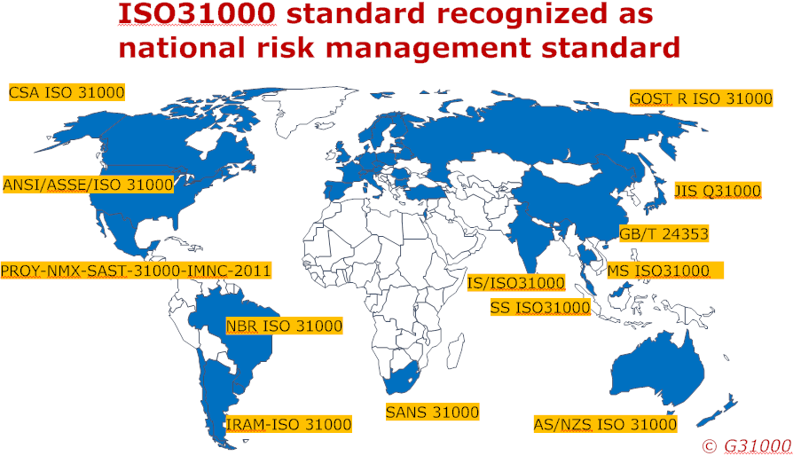
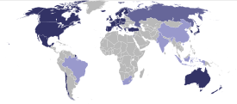
About ISO 31000
TS ISO 31000
OECD
Argentina, Australia, Austria, Belarus, Bulgaria, Brazil, Canada, Chile, China, Czech Republic,
Denmark, Estonia, Finland, France, Germany, India, Iran, Israel, Italy, Japan, Malaysia, Mexico,
Netherlands, New-Zealand, Norway, Poland, Portugal, Romania, Russia, Singapore, Slovak
Republic, Slovenia, South-Africa, Spain, Sweden, Switzerland, Thailand, Turkey, United Kingdom,
Uruguay, United States
Notes:
OECD members : Australia, Austria, Belgium, Canada, Chile, Czech Republic, Denmark, Estonia, Finland, France, Germany, Greece, Hungary, Iceland, Ireland, Israël, Italy, Japan, Korea, Luxembourg, Mexico, Netherlands, New Zealand, Norway, Poland, Portugal, Slovak Republic, Slovenia, Spain, Sweden, Switzerland, Turkey, United Kingdom, United States
OECD partners : Brazil, China, India, Indonesia, Russia, South Africa
ISO31000 members :
Argentina, Australia, Austria, Belarus, Bulgaria, Brazil, Canada, Chile, China, Czech Republic, ,
Denmark, Estonia, Finland, France, Germany, India, Israel, Italy, Japan, Malaysia,
Mexico, Netherlands, New-Zealand, Norway, Poland, Portugal, Romania, Russia, Singapore,
Slovak Republic, Slovenia, South-Africa, Spain, Sweden, Switzerland, Thailand, Turkey, United Kingdom, Uruguay, United States

Slide 4
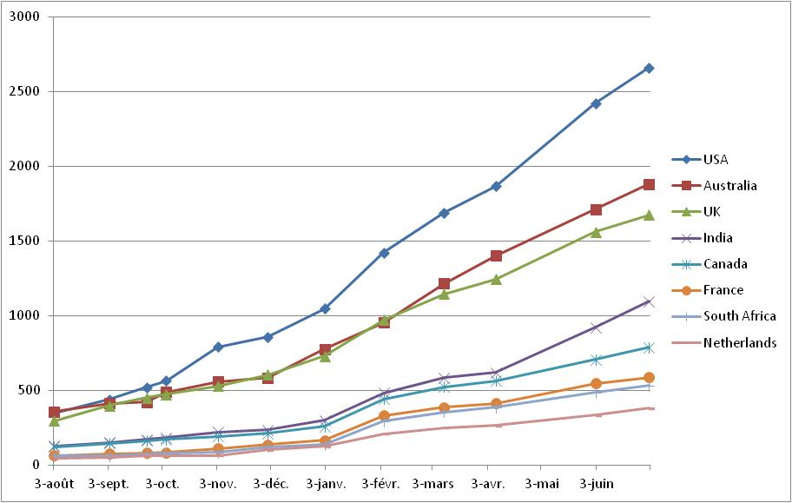
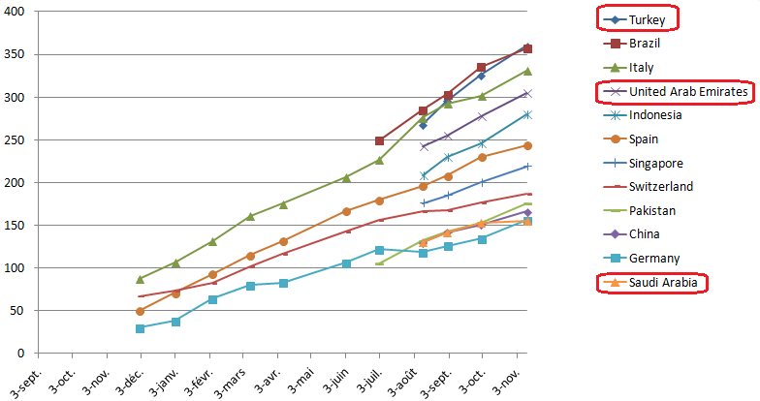
LINKEDIN COUNTRIES

Slide 5
www.G31000conference2012.org

Slide 7
QUIZZ on the ISO 31000 STANDARD
Quizz on the ISO 31000 risk Management standard

Slide 8
QUIZZ on the ISO 31000 STANDARD
Question 1 : The ISO 31000 document is a A Technical specifications for Risk Management B Guidance standard for Risk Management C Certificable standard for Risk Management D Umbrella standard for in existing or future standards

Slide 9
ISO 31000, a risk management standard for decision-makers
DAY 2
Time : 10:00 – 10:30

