Slide 1
New Frontiers on Accountability of Multi-Stakeholder Partnerships
ECOSOC Partnership Forum, 31 March 2016
Dr. Nils Simon
Stiftung Wissenschaft und Politik, German Institute for International and Security Affairs, Berlin
Project on Partnerships for Sustainable Development
www.sfb-governance.de/ppp

Slide 2
Multi-stakeholder partnerships
Are considered flexible and innovative means to enhance sustainable development
Create win-win situations across sectors and enhance synergies by pooling resources
But data shows:
Failure is widespread among MSPs
Most MSPs operate in OECD countries and emerging economies
Ad hoc nature, rarely long-term and transformative

Slide 3
Enhanced accountability: Tasks for the UN system
A/RES/70/224: “develop a common and systemic approach, for those partnerships in which [the UN system] participates,”:
Encourage all MSPs to register
Provide guidelines and rules (due diligence) (and implement)
Provide support for MSPs
Refine reporting requirements (and work with reports)
Encourage learning and knowledge sharing among MSPs
Prepare the review of MSPs’ contributions to SDGs
Need to differentiate between UN-led MSPs and those without UN involvement

Slide 4
1 Registration
UNDESA could ask all UN agencies and programs involved in MSPs to register them with the Partnerships for SDGs platform
Encourage all MSPs relevant for implementing the SDGs (incl. those without UN involvement) to register
Enhance the registry and database:
Link with information held by private sector focal points or others
Implement regular reporting mechanism; flagging/delisting non-reporting MSPs
Notes:
UNTT = UN System Task Team on the Post-2015 UN Development Agenda
TST= Technical support team, co-chaired by UNDESA and UNDP

Slide 5
2 Principles, guidelines, due diligence
Build on existing guidelines (e.g. Bali G. and Business G.) and new principles (2030 Agenda),
Discuss overarching principles for all MSPs in the ECOSOC Partnership Forum, and decide on them in ECOSOC or GA
For UN-led MSPs:
Decide on concrete guidelines and a coherent process for implementation, providing sufficient capacities for UN system
Further pool due diligence procedures and externalize screening
For all other MSPs in the Partnerships for SDGs online database:
Set up a lighter framework with appropriate guidelines

Slide 6
3 Coordinated support and follow-up by UN
Specify division of labor among UN entities for support:
UNOP build and maintain network of MSP focal points within UN agencies and programs
GCO align annual Communication on Progress reports by businesses with SDGs
Impartial third entity tasked with integrity measures and impact assessments
Inter-agency committees help mainstream principles and guidelines throughout the UN system
Notes:
UNTT = UN System Task Team on the Post-2015 UN Development Agenda
TST= Technical support team, co-chaired by UNDESA and UNDP

Slide 7
4 Reporting
Mandatory reporting of UN-led MSPs to ECOSOC/HLPF/GA
Self-reporting for all registered MSPs (on at least a biennial basis) through submission of short reports to the online platform
Take note of existing third-party reports
Have an independent expert (panel) prepare a synthesis report to inform ECOSOC Partnership Forum / HLPF reviews

Slide 8
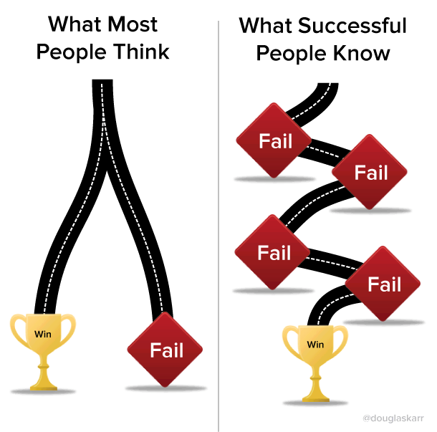
5 Learning and knowledge-sharing
Facilitate annual meeting of MSPs with focus on knowledge-sharing and learning
Create informal settings as “safe space” for open exchange among MSPs, including experts and stakeholders, allow them to also learn from failure
ECOSOC Partnership Forum could discuss lessons learned and evaluate effectiveness of guidelines and policy frameworks

Slide 9
6 Review
HLPF to review partnership contributions – but how to best prepare this, building on existing structures, processes, and mandates?
Partnerships for SDGs Platform/ECOSOC Partnership Forum: Collect and discuss (synthesis) progress reports by/on MSPs (esp. with UN involvement), also informing HLPF reviews
Private, business, and civil society reporting: Make use of independent reviews of MSPs and allow complementary input
HLPF review: Discuss contributions of MSPs within
Review of overall progress;
Thematic reviews based on the annual theme; and
National reviews

Slide 10
