Slide 1
LES VOLONTAIRES DE LA SANTE (ONG LVS)
ONG LVS
&
http://onglvs.blogspot.com
http://www.worldviewmission.org
PRESENT NGO LVS PROJECTS IN COTE D’IVOIRE

Slide 2
1)- PRESENTATION OF THE ORGANIZATION
Name of Organization: Les Volontaires de la Santé (NGOs LVS)
Address: Abidjan Yopougon, 01 BP 8554 Abidjan 01, Cote d'Ivoire
Tel: (225) 23 46 34 27 - Cell: (225) 07 93 74 13/05 27 56 77
E-mail: lesvolontaires_ongsante@hotmail.com
Website: http://onglvs.blogspot.com
Networks:
http://www.recim.org/ascop/volsan-fr.htm
http://www.recim.org/ascop/man-volsan.htm
Name of President Founder: KOUAME Abissi Raymond
Date created: 08/06/2003
Legal status: Non Governmental Organization
Approval Decision numbers:
- Declaration of Association No. 05/MEMAT/DGAP/DAG/SDVAC of 26 February 2006 and submitted to the Organic Law No. 60-315 of 21 September 1960 the Republic of Côte d'Ivoire,
- Official Journal of the Republic of Côte d'Ivoire from 2 March 2006.
- Ministry of Health and Public Hygiene: No. 1428 / MOH / CAB / CT5 / Y 2 March 24, 2006
Management Structure: General Assembly, Board of Directors, Executive Board,
Number of members: 13 Total Enrolment: 37 employees, 10 volunteers
Financial Capacity: 5 000 000 F CFA = Euros 7 622,45 = USD 10 000
Worldview Mission (WM) International Ms. HÉLÈNE H. OORD,
Founder Worldview Mission Int’l. Headquarter the Netherlands (EU)

Slide 3
2)- PARTNERS:
- Ministry of Health and Public Hygiene
- NGOs PLAYDOO,
- City Town of Yopougon
- Computer Library of Côte d'Ivoire,
- IMAN Consulting
- NGOs Ivory Coast Prosperity,
- IPE Development Club
- NGOs AEC
- NGOs ADAM
- Worldview Mission (WM) Int’l (http://worldviewmission.nl/?page_id=5961 )
- World Citizen France
- Share Here and Else where France
OUR GOAL
To contribute significantly to improve needy populations and communities social, sanitary, educational and economical conditions.
OUR OBJECTIVES
To reduce the rates of morbidity and mortality and to promote global health,
To reduce poverty,
To improve the knowledge and educational level of needy young people,
To create an International Partnership for a durable development
OUR ACTIVITIES
Medical and paramedical activities
Medical Consultations, Health cares,

Slide 4
xaminations of laboratory,
Pharmacy
Home Health cares services
Preventive, educational and promotional activities
Maternal and Infantile Health, Nutrition and Dietetic.
Fight against the IST/AIDS, Malaria and other diseases according to National Programs’
Scholarships and grants for needy families with our Education Partners,
Assistance in Management projects management, financial research
Support with the ONG, Associations and Organizations of development through an International network
Technical support for NGO, Associations and development organization through an International Network
Epidemiological disease prevention to reduce the risks in the different zones of intervention. This approach focuses on immunizations, medical consultation sessions, care and awareness. These campaigns are to conduct medical consultation activities and care, immunization and mass awareness on HIV / AIDS, Health, Malaria, etc..
Training and assistance are the processes by which the NGO LVS hopes to participate in the poverty reduction. These courses focus on the creation of IGAs (Income Generating Activities).
The NGOs also provide technical assistance in installation and project management of development structures that work to create wealth for youth and women. Also should be noted that the NGO grants, in collaboration with its partners in education, scholarships and supported school for orphans and children from poor families.
Direct interventions are consultations and care in Health Promotion Centers (PSC) of the NGO. These services are billed at flat rates and for low-income people who cannot go in public and private hospitals. These interventions are used to relay government action became increasingly inadequate and ineffective in practice.
OUR STRATEGIES
Opening Health Promotion Centers
Community Mobilization and Sensibilization
Education, Formation, Assistance
Technical Support
Income Generating Activities (AGR)
Social and Medical Assistance Fund (FAMS)
OUR TARGET POPULATION
Children from 0 to 5 Years Old
Women
Young
Old people

Slide 5
ACTIVITIES PERFORMED
Since June 2003: It has contributed to support Social and medical services for over 1000 families in Abidjan and Assinie. Among its actions, we can mention:
- October-November 2004: Community mobilization, sensitization, counseling and medical care in and VridiAko-Ile Boulay (Abidjan).
- The creation of three centers of community-based health centers (Health Promotion):
August 2005: Ile Boulay;
October 2006: Kumasi Soweto;
November 2006: Yopougon.
- January-February 2006: Visit to the sick at home who received and treated at CPS-IB (Survey on vaccination status of the population of the Ile Boulay).
- June 2006: consultation and free medical care to 296 children 0-15 years at Ile Boulay
- September 2006: Distribution of 300 Fellowships over $ 60 million based on our agreement with Local Partners for Education and Training (Unix Academy, NGOs AEC, IPE Development Club, IMAN Consulting).
- November 2007 - 2008: Launch of the project "Health Assinie" Several days of consultations, free health care and immunization at K9 Assinie
- 2007 & 2009: Visit of MrsStrazzullaAntonine, President of the NGO Sharing Here and Elsewhere from France at CPS Kumasi SOWETO accompanied by me YAO, President of the Federation of Women's Groups of Kumasi and Mr. DON MELO Rose.
- 2007 - 2008: Medical Coverage of the 6th and 7th finals Edition of the Christian national theatrical competition and delivery of Fellowships to the winners.
- 2009: Implementation of two Cooperatives structures (Coop. BOUEDJE Tronin and HOREB Association).
2009 - 2010: Medical coverage of Assinie Beach in August 2009 & August 2010
c)- PRESENTATION OF THE PROJECTS TEAM
1 - KOUAME Abissi Raymond, President, Programs and Projects Officer
2- KOUASSI Yao Marcel :Assinie Representative
3 - AbouoDjama Clement, Secretary, Technical Officer

Slide 6
4 - KOUAME Roland, Logistics Officeer
5 - Serge BITTY, Social Communication, Head of health awareness
6 - EDI Christelle, Finance & Accounting Officer
7 - KONAN AhouSolange, Social Activiies Officer
8- Ms. HÉLÈNE H. OORD, UN Counselor/ Liaison to the United Nations
The mission of "Health Volunteers (NGOs LVS)" is to create the conditions of overall well-being for people and disadvantaged communities by promoting global health through the creation of Health Promotion Centers, providing a technical assistance to community-based organizations in the areas of solidarity project Management and sustainable development, raising his target on the creation initiatives Income Generating Activities (IGAs) and promoting the training of young people through granting of taking charges and School Fellowships.
Since 2003, the NGO LVS is actively contributing significantly to the improvement of Social, Health, education and economic more than 1000 families.
Its activities cover both the Abidjan area than those of the country.
It was active in the communities of Abidjan, Agboville, Assinie, and intends to expand its operations across the country and in neighboring countries.
Following the crisis in the country, it had to suspend its activities and organized to reopen its headquarters and Health Promotion Center in Yopougon and Assinie.
To carry out this program, the NGO LVS needs medication, supplies, medical equipment and other computer hardware and financial resources needed to achieve these types of projects.
The post-election crisis has caused a health emergency aggravated by the disorganization of the health system because of widespread looting.
The achievement of the MDGs respectively on reducing child mortality, improving maternal health and the fight against HIV / AIDS, malaria and other infectious diseases remains unlikely.
Despite the efforts of the State, development partners and households, the situation remains alarming due to morbidity and high mortality due to malaria and HIV / AIDS.
In addition, the healthcare system is inefficient is characterized by: an unequal distribution of staff across the country, low population's access to health services and quality medicines at lower cost. Disability health systems are also amplified by the lack of financial resources, weak information systems and management, inadequate sanitation and poor hospital and Management of Biomedical Wastes.

Slide 7
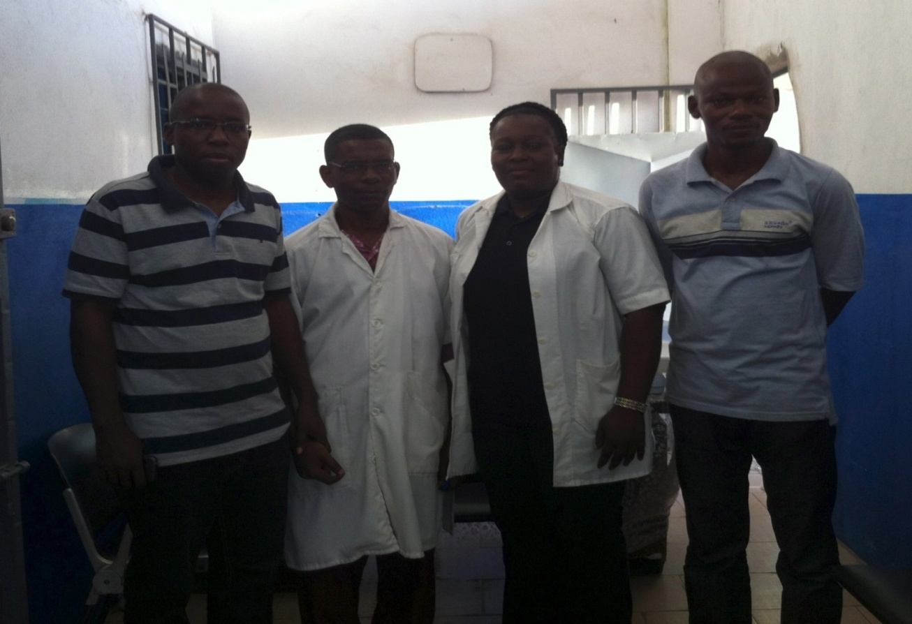
A- YOPOUGON'S HEALTH PROMOTION CENTRE PROJECT

Slide 8
1- PROJECT DESCRIPTION:
BROAD LINES:
The present project falls within the framework of the Millennium Development Goals (MDGs) adopted by all member states of the United Nations in 2000, planning to work together in pursuit of a shared future for all, including policy national and / or international efforts towards the implementation of strategy and mechanisms needed to build an inclusive society where all ages, classes and social strata find their place in the respect and dignity. It is part of the National Policy of the Ministry of Health and Public Hygiene to provide all communities with health facilities in order to provide for their populations a favorable condition for any development and also in the shares of LVS NGO for disadvantaged populations.
Thus, the Project for Opening a Health Promotion Centre in Yopougon aims to help people through health care, economic and social. It aims to provide different populations of curative care, prevention and health promotion as well as medical care for AIDS patients and people living with HIV / AIDS, hypertension and diabetes.
Indeed, the Yopougon district does not have enough, social health structures that can meet the health needs of their populations.
The NGO intends to integrate its activities Training and Support Centre in through the activities of the office.
2- CONTEXT AND ORIGIN
The socio-political instability since the coup of 1999, military and political crises of 2002 and the post-election crisis of 2010/2011 had a severe impact on the economic, security, social and humanitarian law in Côte d’Ivoire.
It meant to amplify the lack of public access to basic services such as potable water, electricity, education and health has certainly exacerbated the problem of poverty already latent and critical in 2008.
The difficulties of companies show the damage to the private sector. Partial destruction of the means of production has led to the closure of several business and therefore the establishment technically unemployed and dismissal of many workers. The situation is characterized by rampant unemployment, especially among young people, because of the inadequacy of the education system with the needs of the economy, the lack of a coherent policy for the creation and funding of employment , an institutional framework unfavorable and ineffective policy of promoting self-employment and the weakness of reliable statistics.

Slide 9
Per capita income has declined by one-sixth over the last ten years, and half of the population lived below the poverty line in 2010. The main objective of the government is to reduce the incidence of poverty of 48.9% in 2008 to its pre-crisis level of 1999 (33.6%) in 2013 and to reach 16% by 2015.
Côte d'Ivoire is among the countries with low human development (ranking 170th out of 187 countries in 2011). Expenditures for the poor are estimated at 10% of GDP in 2011 against 7.8% of GDP in 2010.
The educational environment has been heavily damages caused by social disruption since 2002. The education system still faces major difficulties of several kinds, among which, the weak performance of the education system, accessibility and management. In addition, the education sector known difficulties related to budgetary constraints, poor management of resources, lack of infrastructure and instructional materials, outdated equipment and a poor spatial teaching staff. These constraints are compounded by the high rate of illiteracy, social inequalities and the spread of HIV / AIDS in schools. The net enrollment rate at primary education is 56.1% in 2008 and the completion rate of primary education of 51.1%.
The post-election crisis has caused a health emergency aggravated by the disorganization of the health system because of widespread looting.
The achievement of the MDGs respectively on reducing child mortality, improving maternal health and the fight against HIV / AIDS, malaria and other infectious diseases remains unlikely.
Despite the efforts of the State, development partners and households, the situation remains alarming due to morbidity and high mortality due to malaria and HIV / AIDS.
In addition, the healthcare system is inefficient is characterized by: an unequal distribution of staff across the country, low population's access to health services and quality medicines at lower cost. Disability health system are also amplified by the lack of financial resources, weak information systems and management, inadequate sanitation and poor hospital and Management of Biomedical Wastes.
According to the fourth report monitoring the Declaration of Commitment on HIV / AIDS in Côte d'Ivoire remains one of the most affected countries in West Africa. The rate of HIV prevalence is estimated at 3.4% in 2010. However, the effectiveness of multisectoral in the fight against AIDS, deconcentration and decentralization of services and monitoring and evaluation of the national response have yielded some results.
Indeed, the number of patients on antiretroviral therapy (ART) has increased from 2473 in 2002 to 72,011 in 2009. The proportion of the population with advanced infection with access to ART has increased from 21.3% in 2006 to 41.2% in 2009. These improvements have been facilitated by the free ARV treatment since 2008 and the decentralization of the medical care of persons living with HIV / AIDS by the

Slide 10
multiplication of sites supported. Regarding the fight against malaria, the rate of use of impregnated mosquito nets rose from 3% in 2006 to 14.8% in 2008.
Abidjan, the economic capital is not known margin of the difficulties the country.
Population, major victim of this system, using methods of fortune for health care, practicing self-medication to perfection, people flee public hospitals because of long orders and the poor quality of service.
In terms of communication, no action and awareness is conducted to make people aware of the risks posed by unsafe, risky sexual behavior and self-medication.
Abidjan, the economic capital is not out of the difficulties known in the country.
Population, major victim of this system, using methods of fortune for health care, practicing self-medication to perfection, people flee public hospitals because of long prescriptions and the poor quality of service.
In terms of communication, no action and awareness is conducted to make people aware of the risks posed by the insalubrity, risky sexual behavior and self-medication.
3- OBJECTIVES OF THE PROJECT
Global objective:
Improve the health conditions of people in the neighborhood of Yopougon
Specific Objectives:
- To ensure the medical cares and social services
- Promote Global health
4- PROJECT DURATION:
The total duration of the project to open a health center in Yopougon is 20 years.
5- PROJECT JUSTIFICATION

Slide 11
The project will:
1) open a Health Promotion Center,
2) conduct preventive health and health promotion activities
3) to train committees and opinion leaders on HIV-AIDS, Malaria, Diabetes and hypertension;
6- METHODS REQUIRED FOR THE IMPLEMENTATION OF THE PROJECT
The implementation of this project is based on a participatory approach.
7- IMPACT OF THE PROJECT
- A functional Health Promotion Center for medical cares;
- 1,000 families followed in the first year;
- A service counseling, screening and monitoring of patients living with HIV / AIDS, diabetes and hypertension open
- An open Ambulatory Cares Service
- Implementation of training programs for leaders of local committees and opinion leaders on HIV-AIDS, Malaria, Diabetes and Hypertension
- Health and well being improved,
- Morbidity and mortality in the population are reduced
8- OVERALL BUDGET ESTIMATED:
The total project cost is estimated at 74 474 980 FCFA=113 536,38 Euros= 148 949,96 USD for a period of one year, equipment costs and operation including.

Slide 12
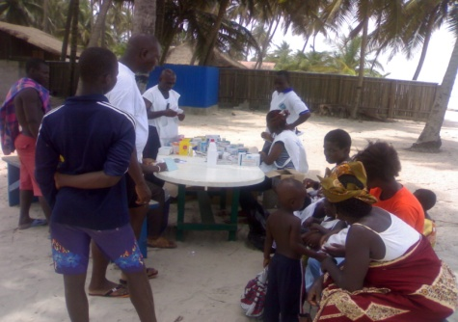
HÉLÈNE H. OORD ASSINIE INT’L HEALTH PROMOTION CENTRE

Slide 13
1-PROJECT DESCRIPTION:
BROAD LINES:
The present project falls within the framework of the Millennium Development Goals (MDGs) adopted by all member states of the United Nations in 2000, planning to work together in pursuit of a shared future for all, including policy national and / or international efforts towards the implementation of strategy and mechanisms needed to build an inclusive society where all ages, classes and social strata find their place in the respect and dignity. It is part of the National Policy of the Ministry of Health and Public Hygiene to provide all communities with health facilities in order to provide for their populations a favorable condition for any development and also in the shares of LVS NGO for disadvantaged populations.
Thus, the Project for opening a Health Promotion Centre in Assinie km 9 aims to help people in the community by providing curative care, prevention and global health promotion.
Indeed, the town of Assinie that abounds several thousand people living in private residences, villages and hotels doesn’t have enough health facilities to provide them primary health cares.
This project will fill this gap that exposes the population to diseases and the risk of epidemics.
2-CONTEXT AND ORIGIN
The socio-political instability since the coup of 1999, military and political crises of 2002 and the post-election crisis of 2010/2011 had a severe impact on the economic, security, social and humanitarian law in Côte d’Ivoire.
It meant to amplify the lack of public access at basic services such as potable water, electricity, education and health has certainly exacerbated the problem of poverty already latent and critical in 2008.
The locality of our project is located 22 km from with an estimated population up to 10 000 inhabitants.
The study of the local environment exposes the paradox of the coexistence of precariousnessand luxury as this locality by our project is close to leisure clubs, hotel complexes and beautiful high standing buildings luxuriously appointed belonging to Europeans or rich personalities of the country.
The natural environment itself, with its beautiful beaches, has the distinction of being located between the sea and the lagoon.
All this beautiful landscape eventually convince the visitor of the heavenly aspect of this place, suspecting the lack of health infrastructure necessities.
Next to the tropical paradise is located the villages of Babihan, Assouande, Mandjan and Ebotiam with an estimated population more than 10,000 people, the majority are employees of hotels and private properties.

Slide 14
Employees live in informal settlements with indescribable precarious conditions.
To this must be added the lack of health infrastructure for their medical cares and even care for their basic necessities despite numerous accidents (Boats, Cars, Cowards, Drowning). The nearest health center is located at 22 km from the locality, forcing the people of this community to use self-medication.
All these reasons motivate us to provide health services to the population, visitors and tourists who spend their weekends through the opening of a Health Promotion Centre.
This center aims to provide curative, preventive and emergency health cares to all communities living in the area.
3- PROJECT OBJECTIVES
Global objectives:
Improve the health conditions of the population of Assinie
Specific objectives:
- To ensure the medical cares and social services
- Promoting global health
4- PROJECT DURATION:
The total duration of the project is 20 years.
5- PROJECT JUSTIFICATION
The project consist:
1) to open a Health Promotion Centre including a dispensary and a maternity ward.
2) to train committees to fight against HIV / AIDS in different villages and hotels
3) to carry out preventive activities and health promotion.
6- METHODS REQUIRED FOR THE IMPLEMENTATION OF THE PROJECT
The implementation of this project is based on a participatory approach.
People express a desire to rub a health center in which their concerns will be taken into account. To do this, the NGO has been working with the village authorities and representatives of resorts for the establishment of a management committee. Which will promote community involvement in the implementation of outreach activities.

Slide 15
Several meetings have been initiated as a result of which several actions were taken to the Ministries of Interior and the Ministry of Health and Public Hygiene to accelerate administrative procedures.
Several meetings with the Assinie Sub-Prefect were also held.
We have just acquired an office in Assinie to start activities.
We need to do the renovation and equipment of office.
7- IMPACT OF THE PROJECT
- Medical care through consultations and health cares.
- Implementation of training programs for officials of local committees and leaders on HIV-AIDS, malaria and other endemic diseases;
- Supports of pregnant women byprenatal consultations, children and infants by monitoring the weight and height growth.
Vaccination of children, pregnant women and women of childbearing age.
8- OVERALL BUDGET ESTIMATE:
The total project cost is estimated at 85,876,200 CFA francs (130 917.43 euros , USD 171752.4), renovation costs, equipment and operation of 12 months including
3- CONTACTS Information:
WORLDVIEW MISSION (WM) INT’L
Ms. HÉLÈNE H. OORD, UN Counselor & Liaison to the United Nations
Headquarter , Netherlands (EU)
Address: Beemsterhoek 14
2905 XA , Rotterdam - Capelle Aan Den IJssel, ( Netherlands – EU )
Registered RSIN ANBI 851082403 B01 / http://worldviewmission.nl/?page_id=150
Mobile: +31 (0)6 3610-8563 / Land-Line Phone / Fax +31 (0)1 0785-7863
Skype: helene.oord / Skype: helene.oord21

Slide 16
E-mail:info@worldviewmission.org / worldview.mission@gmail.com / Site:http://www.worldview.mission.org
Banc Account Info Netherlands : http://worldviewmission.nl/?page_id=150
Stichting Worldview Mission
Bank: ABN-AMRO 506082202
IBAN: NL 81ABNA0521637651
Registered RSIN ANBI 851082403 B01 / K.v.K. 53.94.11.36
CÔTE D’IVOIRE- Abidjan
Mr KOUAME Abissi Raymond, President, Programme Manager,
Tel: 00225 23 46 34 27/Cel: (225) 07 93 74 13
Skype 1: abissigms, Skype 2: interglobds.gp
E-mail: lesvolontaires_ongsante@hotmail.com
Website: http://onglvs.blogspot.com / http://www.onglvs.ass0.fr
NETWORKS:
French: http://www.recim.org/ascop/volsan-fr.htm
English: http://www.recim.org/ascop/volsan-an.htm
ASSINIE:
Mr Marcel Yao Kouassi, Representative
Contact: 225 02541756/07745659
Banc Account information

