Slide 1
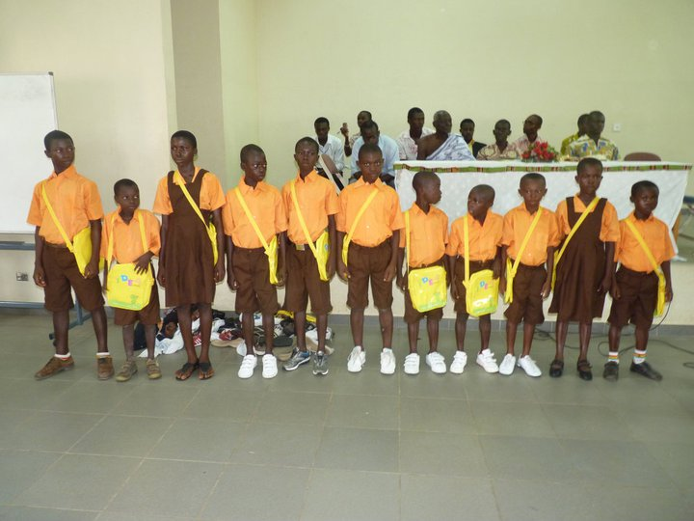
International day of the African child.

Slide 2
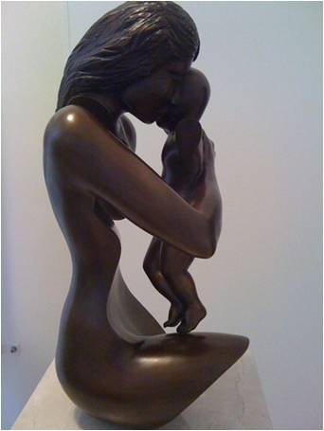

DOLLY FOUNDATION PARTNER WITH WORLDVIEW MISSION

Slide 3
Back to School Project
On the 16th of June, 2011, Dolly Foundation together with Worldview Mission a UN contracted NGO Org. collaborated to marked the International Day of the African child. The celebration was the 2nd ever international day of the African child marked. The first was marked by World Vision International. Dolly foundation a local N.G.O in Assin Foso marked the Day. Theme of the international day of the African child was ‘’ALL TOGETHER, AN URGENT ACTION FOR STREET CHILDREN.

Slide 4
Methodology
Radio announcement for awareness creation.
Sensitization for the need for children in the street to attend school.
Letters were given to all public and private schools in the municipality

Slide 5
Activities and Results
350 school children were involved in a street walk from Obiri Yeboah Secondary School through the municipal street and ended at Latter Day Saint Church.
50 street children were among the school children.
Educational placards:
Yesterday street child is today arm robbery.
Education the backbone of the nation
Education is the key to success
Stop violence against girls in schools
Children education, our concern

Slide 6
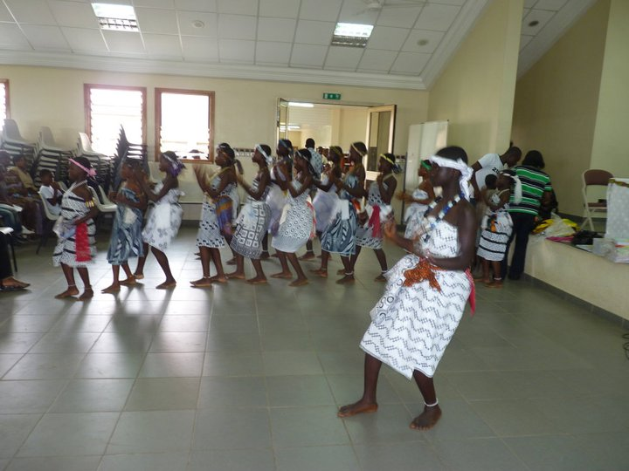
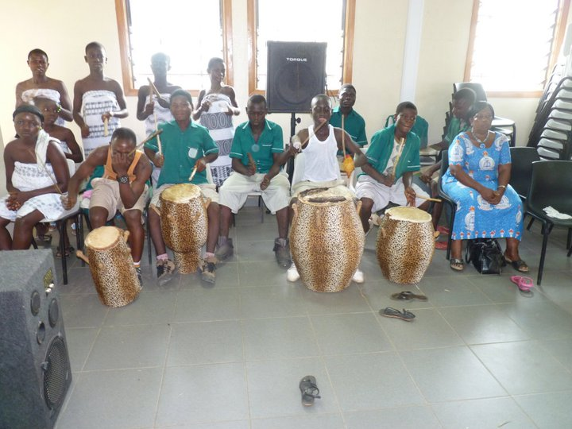
funs games activities by selected schools.
Cultural display by Foso Catholic school
Chorology dance by fosco demonstration school.
Poetry recital by 31st December women movement
Eagle nest community school also entertains the school children and the street children with poetry recital and newscast.
50 street children were given school uniform school bags, shoes and stationary.
Above mentioned items were sponsored by Assin North Municipal Assembly Assin North Education Service

Slide 7
Observation
Awareness of the importance of education
Street children become aware of the need to attend school.
Policy maker realizing that more must be done if we want to say no to streetism.
Scholarship pledges from individual.

Slide 8
Challenges and recommendation
Lack of funding
Were not able to reach out to other communities
Dolly foundation and Worldview Mission
back to school project is a year long campaign which aims at reducing street children and school drop out back to school.
Dolly Foundation and Worldview Mission need more funding support for Advocacy programs for the needs for education.

Slide 9
Attendance
N.D.C Chairman Hon. Kutin
The Director for school welfare Mr. Jonathan Gbewu
Mr. Stephen Adu Gyamfi
School pupils (44 schools , 300 school pupils)
Teachers of the various schools
Media partners / personnel

Slide 10
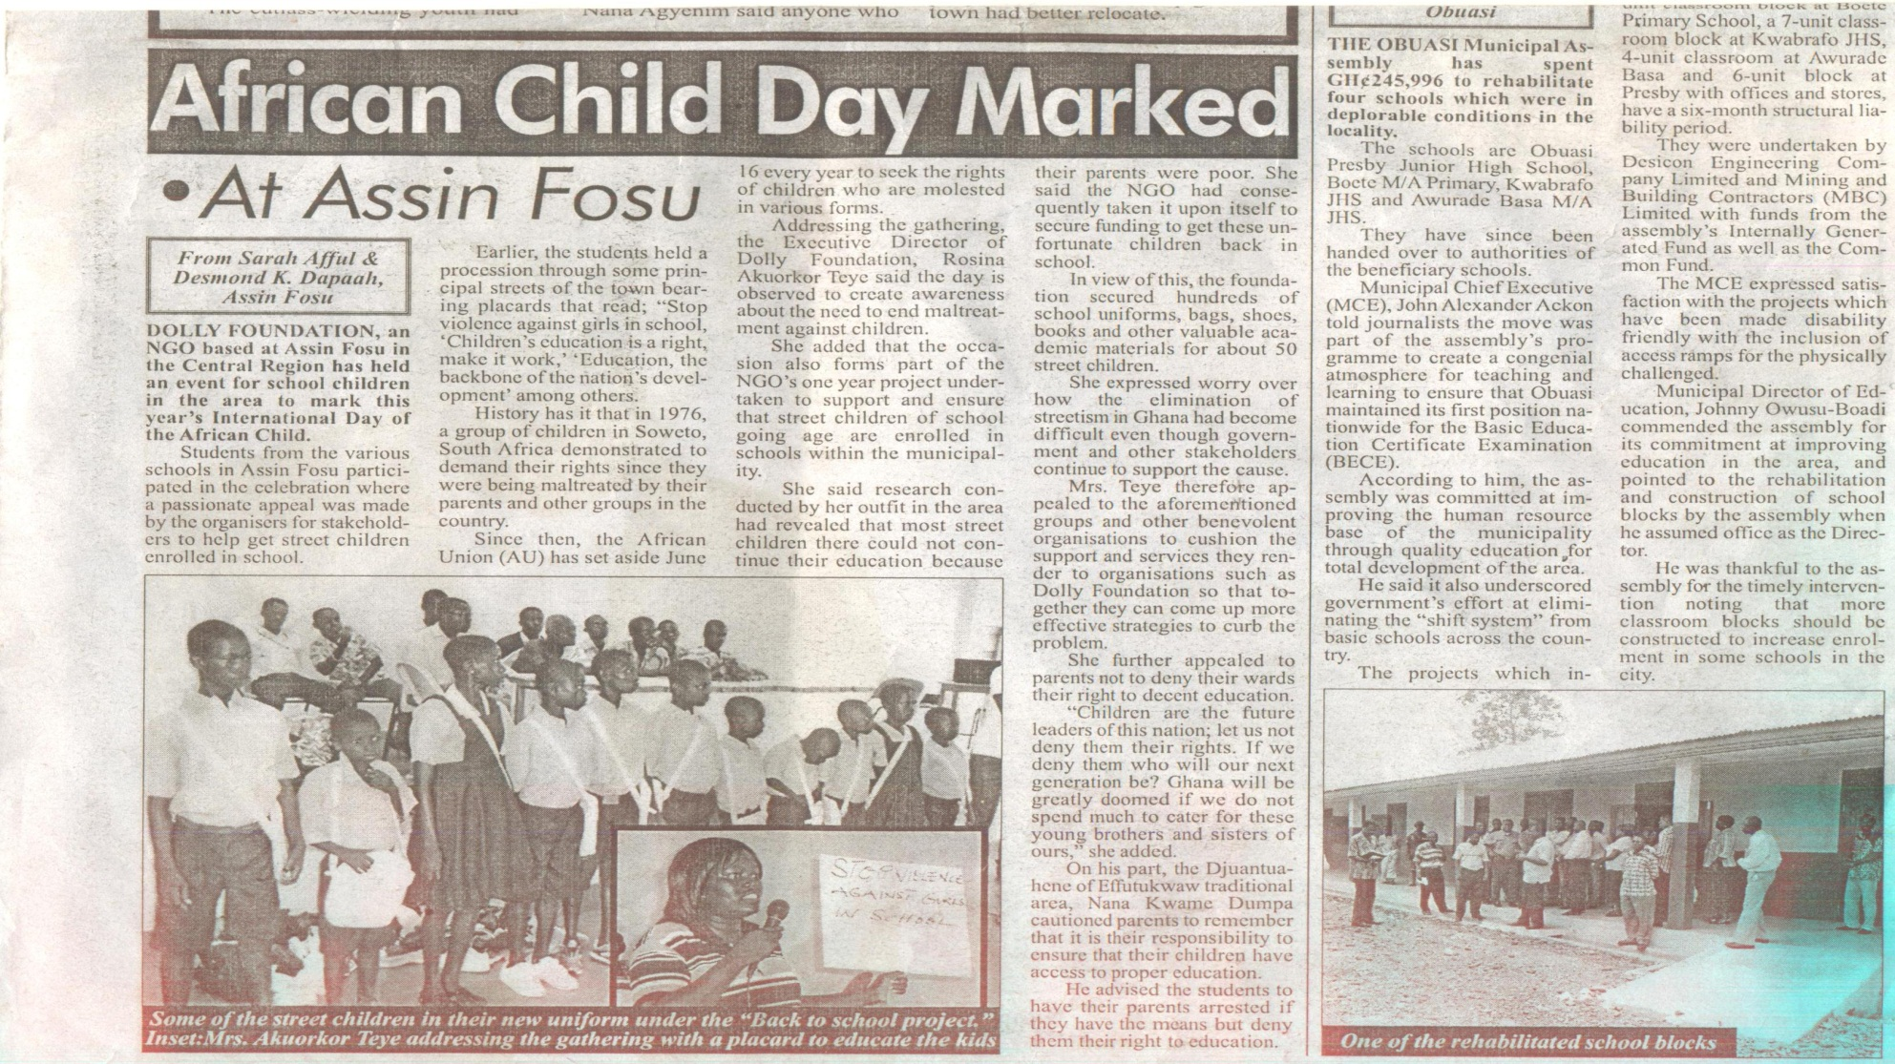
Media publication

Slide 11
Dolly Foundation Profile
Dolly Foundation is a local non governmental organization in Assin Fosu
The organization was formed in January 2009, It got registered in June 2010 with Registrar General Department and social welfare department.
The aims and objectives of Dolly Foundation include the following;
To give appropriate health care, counseling and health education
To investigate, unearth and spell out the basic needs of women To use right and evidence – based approach for improved lives of the poor, vulnerable, voiceless and marginalized in society.
To mobilize and build capacity of the youth to earn a living and support local level development activities
To advocate for, and work with the marginalized individual and communities against inequalities , discrimination and marginalization

Slide 12
Profile Worldview Mission
Worldview Mission (WM) NGO, member of United Nations CSO-NET (ECOSOC CIVIL Society Network NGO Branch, New York.
To connect ministries, with organizations of all sorts by providing information about the concerns of the 8 MDG L’s of the United Nations, and bring awareness of the current activities.
To provide in their needs for a better understanding in our Multicultural society. In other words, to improve communication and support each other’s cause.
To promote, support and improve communication among civil organizations and, the United Nations Missions for rapid and effective coalition between the countries.
Worldview Mission complies with the 8 major MDGL’s and Statements of General Secretary Ban Ki-Moon, of the United Nations to reduce the Poverty by 2015.

Slide 13




Worldview Mission Areas of Concern
Community development
Community service and volunteering
Economic development
Family and Parenting
Poverty and hunger
Education
Leadership
Employment
Micro-finance
Youth Court
GOAL:
To improve de quality of life for the people living in poverty helping them to become self-sufficient.
MILLENIUM DEVELOPMENT GOALS
The Millennium Development Goals (MDGs) are 8 international Development goals that 192 UN member states and at least 23 International organizations have agreed to achieve by the year 2015.

Slide 14
Profile Board of Directors
Dr. Obi Jatex
Worldview Mission, Health dept, Board Member, Nigeria
Lecturer, Toxicologist, Biomedical Scientist,
Department of Pharmacology & Therapeutics College of Health Science,
Nnamdi Azikiwe University Nnewi, Nnewi Anambra State Nigeria
Email: ejeatuluobi@yahoo.com
Ms. Hélène H. Oord Ms. Rosina Akourkor Teye
Worldview Mission Dolly Foundation
Chair & Founder Executive director
Counselor to the United Nation Director Women Affairs African views
Mobile: +31 (0)6 3610-8563 Co host – youth initiatives webcast – African views
Phn+Fx: +31 (0)1 0785-7863 sociologist , legal literacy volunteer and a panel
Skype: helene.oord member for family tribunal
Skype: helene.oord21 Skype : dollylove9
E-mail: Info@worldviewmission.org email: dollylove201060@yahoo.com
Site: http://www.worldviewmission.org site : http://www.dollyfoundationghana.webs.com

Slide 15
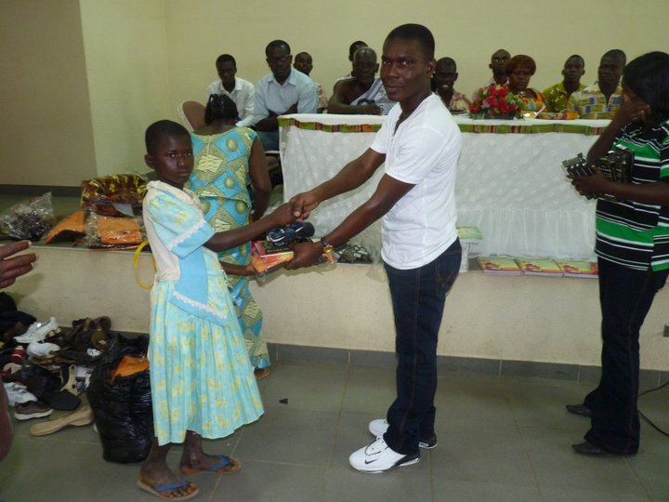
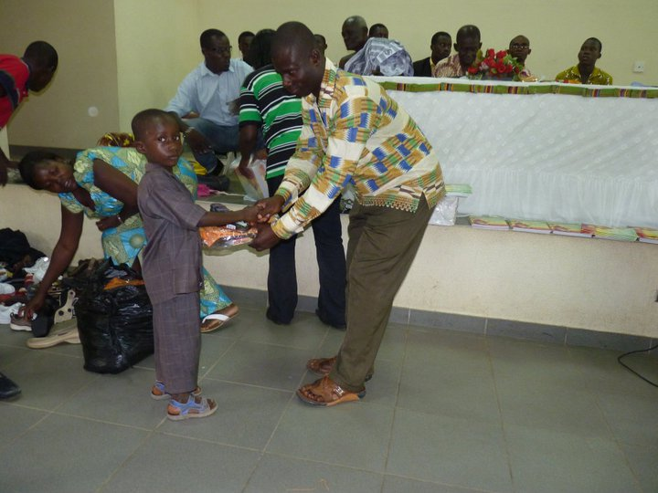
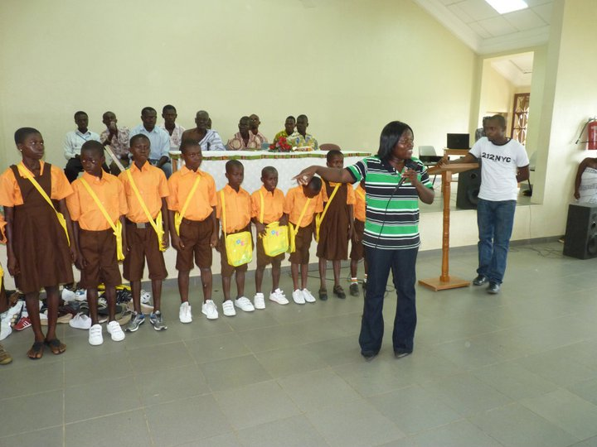
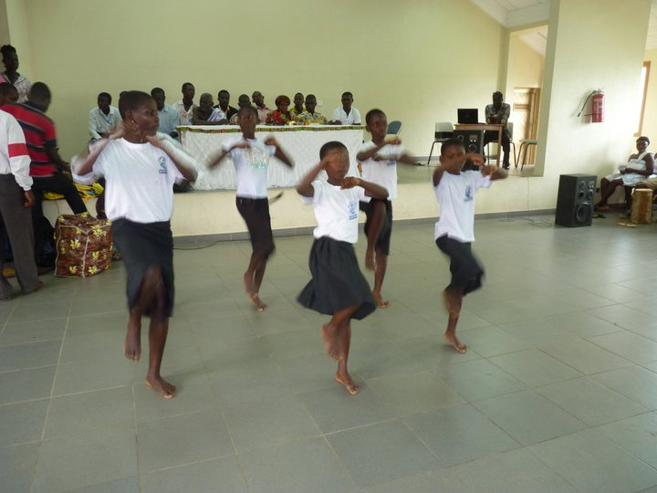
More pictures

Slide 16
Contact us
Ms. Rosina Akourkor Teye
Executive Director, Dolly Foundation
P.O. Box AF 25, Assin Fosu, C/R – Ghana,
Email: dollylove201060@yahoo.com
Website: dollyfoundationghana.webs.com
Tel: +03321 – 95826 Mobile: +233 27-3764195, 020-6742021
Ms. Hélène H. Oord
Worldview Mission
Chair & Founder
Mobile: +31 (0)6 36108563
Phn+Fx: +31 (0)10 7857863
Skype: helene.oord
Skype: helene.oord21
E-mail: Info@worldviewmission.org
Site: http://www.worldviewmission.org

Slide 17

DOLLY FOUNDATION PARTNER WITH
WORLDVIEW MISSION http://www.worldviewmission.org
Women Health Issues. In Women's Words HIV Priorities for Positive Change
http://www.youtube.com/watch?v=GzfF-uF7hQM
Cancer Facts & Figures 2012
http://www.cancer.org/acs/groups/content/@epidemiologysurveilance/documents/document/acspc-031941.pdf
http://www.who.int/cancer/en/
http://www.who.int/cancer/en/
Missing the message about Maternal Morality , http://vimeo.com/2771325
EIGHT GOALS FOR THE UN MILLENNIUM DEVELOPMENT GOALS By: 2015
http://www.unric.org/en

Slide 18

8th UN MILLENIUM DEVELOPMENT GOALS http://www.undp.org/content/dam/undp/library/MDG/MDG%20Acceleration%20Framework/MAF%20Reports/RBA/MAF%20Ghana_MDG5_Low_Web%20(2).pdf

